Slide 1
Struggle bus productions
presents…

Slide 2



Music meets data science
Three musicians walk into a data science boot camp…

Slide 3
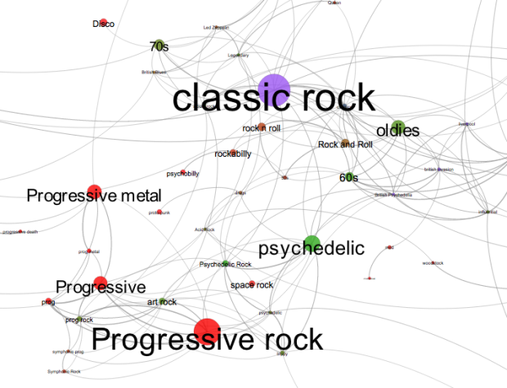
Our goal was to analyze musical trends over time.
Genre
Beats per minute
Song length
Key

Slide 4

Data sources
Gathering Billboard hits from the last ~60 years.
Song title, artist, Top 10 spot, genre, song length, beats per minute, key, and more.
Can we see changes in the genres trending over time? Are song lengths getting longer? What song keys produce the most hits? What BPM is the most prevalent amongst hit songs?
Scrape some hit songs, find a music API, make a json …
TOTALLY GROOVIN’, RIGHT?

Slide 5


Slide 6


Slide 7

Data challenges:
Scraping Billboard site
Music API limitations – many tries and fails
Spotif$#%* API
Json challenges
*depiction of actual events

Slide 8

Resurrecting the bus
Let's have a look at what we found

Slide 9

Machine learning… what to apply?
Like stock predictions, we wanted a linear regression model that could look at features across time and predict what might happen next.
For example: train a model on the year and count of songs in a particular genre…
A NEGATIVE R2?!? Who knew you could have such a thing?
No correlation apparent between count of songs in rock
genre over time, or song tempo over time.
Higher correlation (.85 R2, .05 MSE) for the average song
length over time.

Slide 10
takeaways
Getting data is never simple!!!
Json -> cleaned dataframe makes all your visualization dreams come true.
After first attempting D3 and Tableau, Plotly for Python and Matplotlib turned out to be the winners for visualizing.
Hit songs are getting longer over time (~2.5 minutes in 1960 to ~4.5 minutes modern day).
The changes in popularity of genres are very visible over decades.
Interesting Spotify API applications: touring artists can customize their set list by the Spotify songs that are most popular in that city.

Slide 11


Rock on, Struggle Bus!

